Slide 1
Deep Learning with Apache MXNet
8th March 2019

Slide 2
Why you should care about the DL Framework
Faster prototyping
It allows
Less training time

Slide 3
MXNet Overview

Slide 4






Why MXNet
Deep Learning Framework
Optimized
libraries
8 frontend
languages
Scalable
Debuggable
Flexible
Portable
Notes:
Very efficient library. It works equally well in very large environments: cloud based environment, where it nearly scales linearly to hundreds of GPUs, but it can also run on edge devices where we have resource constraints. We can develop highly efficient models for mobile and IoT devices. For instance Resnet 1024 layer network is roughly 4GB and you can run MXNet on a Raspberry Pi.
Conservative memory usage and very fast.
It provides a hybrid programming model which allows us to have fast efficient models that can easy be debugged.
.

Slide 5
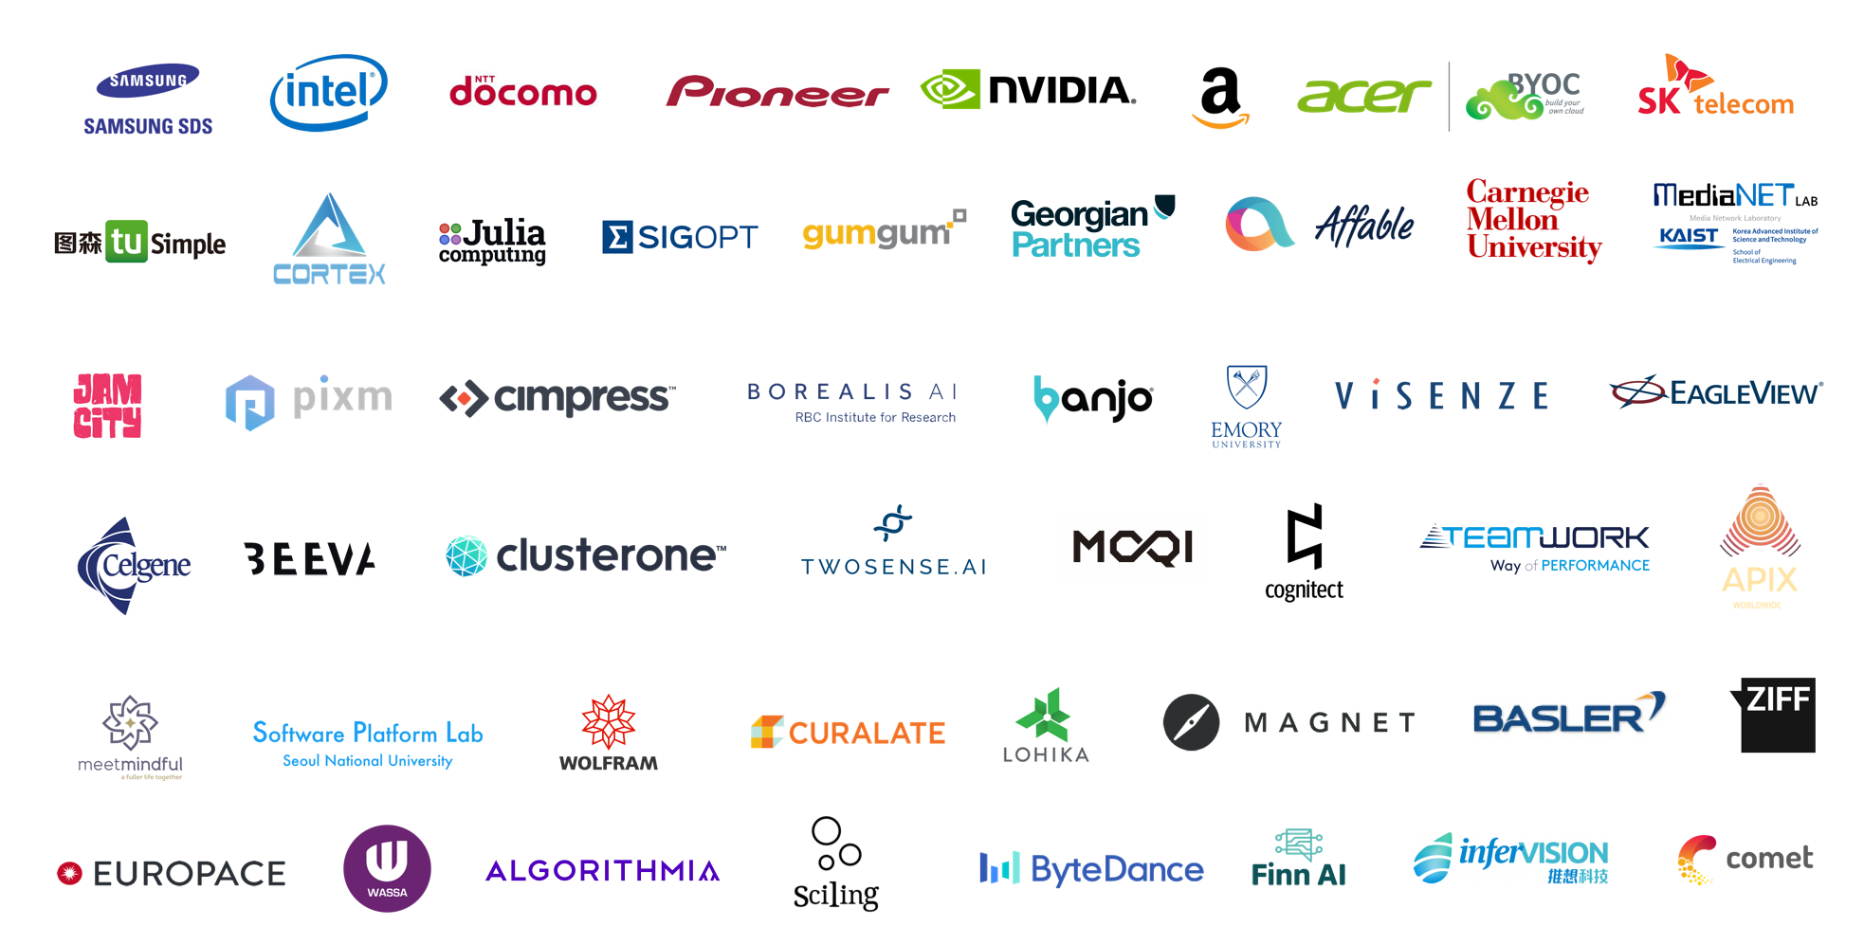
MXNet Customer Momentum
Notes:
Very efficient library. It works equally well in very large environments: cloud based environment, where it nearly scales linearly to hundreds of GPUs, but it can also run on edge devices where we have resource constraints. We can develop highly efficient models for mobile and IoT devices. For instance Resnet 1024 layer network is roughly 4GB and you can run MXNet on a Raspberry Pi.
Conservative memory usage and very fast.
It provides a hybrid programming model which allows us to have fast efficient models that can easy be debugged.
.

Slide 6
MXNet Ecosystem

Slide 7
Multi-language Support
While keeping high performance from efficient backend
R
Perl
Julia
Clojure
Python
Java
Scala
C++
Frontend
Backend
C++

Slide 8
Ecosystem
TVM
ONNX
Model Zoo
TensorRT
GluonCV
Model Server
GluonNLP
MXBoard
Keras
Notes:
MXNet as Keras backend. You can just use your Keras models and run them with MXNet backend and profit from performance speedups.
GluonCV: Deep Learning Toolkit for Computer Vision. Training scripts that reproduce state of the art results. Large set of pretrained models. Can use it for transfer learning.
GluonNLP: Deep Learning Toolkit for NLP. Pretrained models such as embeddings. These toolkits allow that you dont have to start from scratch.
TensoRT:
Nvidia platform that comes with deep learning inference optimizer and runtime that delivers low latency and high-throughput
High-performance deep learning inference.
Layer and Tensor fusion
Precision calibration: int8 fp16 optizimiations
TVM: Model compiler. You tell It what hardware you have and it will compile your model to run on the most optimal way on this specific hardware. Hardware such as Raspberry Pi etc. → hardware portabaility.
ONNX: Open Neural Network Exchange Train a model in Pytorch and execute inference in MXNet. A format that was introduced by Facebook and Microsoft. This format makes life of machine learning researchers much easier. They are not forced to implement their entire pipeline in one framework of choice. But can for instance choose their most favorite framework for researching new models and a use a different framework for productions system when speed matters.

Slide 9



Ecosystem - Imperative API
Debuggable
Flexible
Scalable
Notes:
The nodes of the graph are executed as the Python code executes.
Hybrid:
You don’t need to decide for one or the other. You can just implement imperative and hybridize the network afterwards
Debuggable: Gluon API every execution comes back to Python and you can plug in a debugger to check shape of tensors, values of the gradients, heatmaps of gradient updates.
Flexible: combines imperative and symbolic

Slide 10
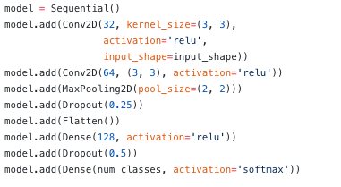
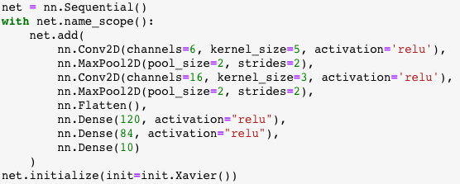
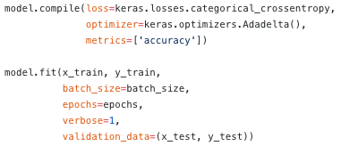
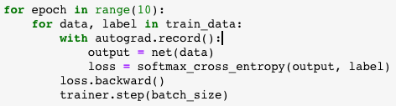
Imperative versus Symbolic
e.g. Inception Stage
Symbolic is “define, compile, run”
Imperative is “define-by-run”
Notes:
A deep Learning model is a computational graph where you define a series of computations and operations and pass data through it.
2 approaches to build computational graph:
Symbolic: Define variables, computations. One this is defined, you would compile the model into an IR that defines the links between all the tensors in every step of the operation.
Engine takes care of building the graph and optimizing it. For instance the engine can check how to reuse memory, which operators to fuse. It can do a proper graph optimiztions. Difficult to debug because of lazy evaluation: until we execute the graph we don’t know what will happen. It build first the graph, and then binds the data.
E.g. loss is not converging, tensor shape mismatch -> very little visibility of what is happening, blindly debug the code, no insight because lazy evaluation
That’s how Caffee, Tensorflow worked. Keras example. Compile->, fit
Imperative programming: straightforward and flexible. It is hard to optimize.
Mixed programming combines advantages of both worlds.
Take advantage of language native features such as loops, conditions and debugger. Execution is driven by the host language. Definition step is the same like the symbolic one.
You don’t give a bunch of data and then call fit. You go through every epoch and each epoch we pass batches of data, get the loss, do the backward propagation of the gradients and update parameters with respect to the loss.
Fast to prototype. You don’t have to develop the full network and once call fit figure out why it crashed.

Slide 11
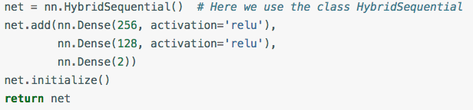
Hybrid programming
Develop and debug using pure imperative programming
Convert program into symbolic programming to achieve best computing performance using graph optimizations techniques
net.hybridize()
30% faster
Notes:
When you are ready, you debugged the model, it is training well, you can start recording: during first batch it is recorded what is happening, each operation is recorded in a symbolic form. Second batch is using the cached operators.

Slide 12
Distributed Training
New!
Notes:
Horovod is an open-source distributed deep learning framework created at Uber. It leverages efficient inter-GPU and inter-node communication methods such as NVIDIA Collective Communications Library (NCCL) and Message Passing Interface (MPI) to distribute and aggregate model parameters between workers. It optimizes the use of network bandwidth and scales very well with dense deep neural network models. It currently supports several mainstream deep learning frameworks such as MXNet, Tensorflow, Keras, and PyTorch.

Slide 13
Distributed Training
Notes:
When training a ResNet50-v1 model using ImageNet data set on 64 GPUs across eight p3.16xlarge EC2 instances each equipped with eight NVIDIA Tesla V100 GPUs on AWS cloud, we achieved a training throughput (i.e. the number of samples trained per second) of 45000 images/s(a scaling efficiency of up to 80%). The training converges in 44 minutes after 90 epochs with a top-1 accuracy of 75.7%.

